Slide 1
Lucky cafe

Slide 2
Made by:
Aranyás Anna – Coffee types
Csapó Zétény - Blog
Filetóth Bence – Cookie types
Blaner Krisztián – Main page

Slide 3
Customer wishes
Modern, aesthetic, responsive website

Slide 4
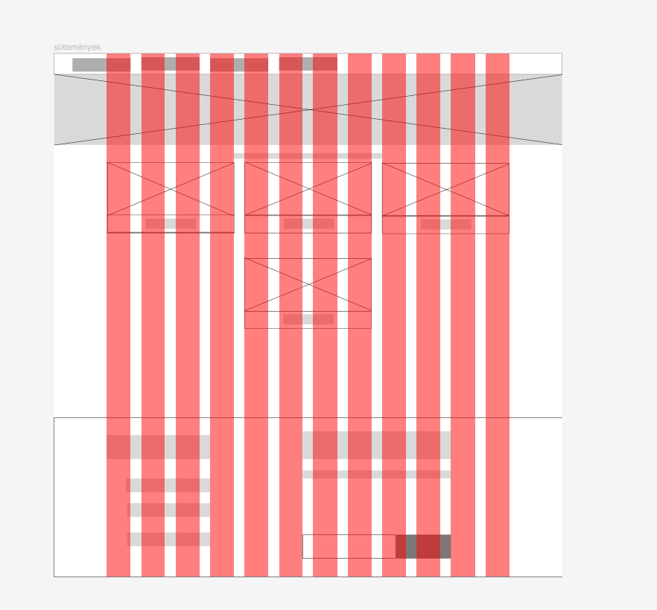
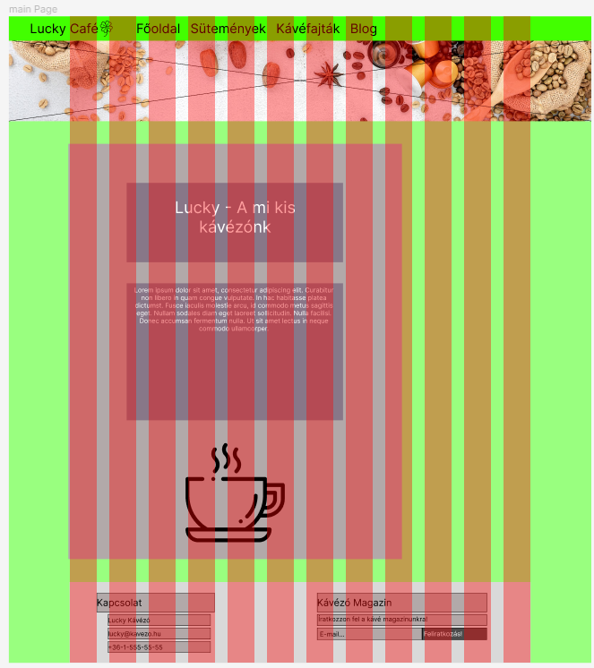
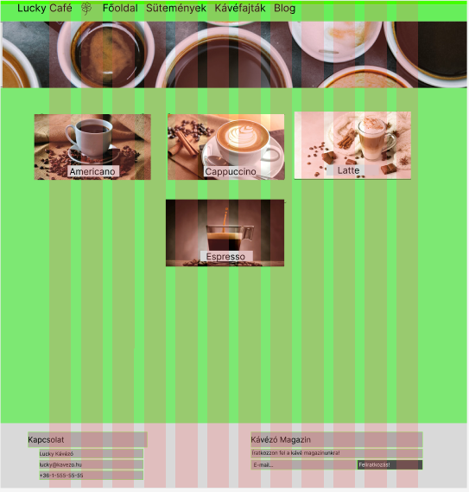
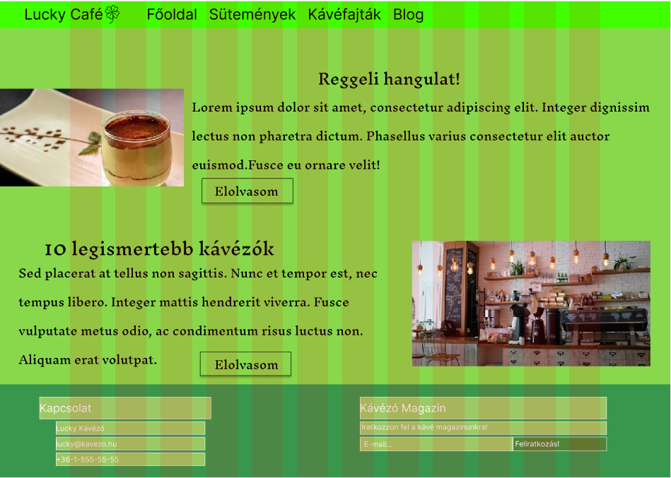
Old website images
Cookie types
Coffee types
Main page
Blog

Slide 5
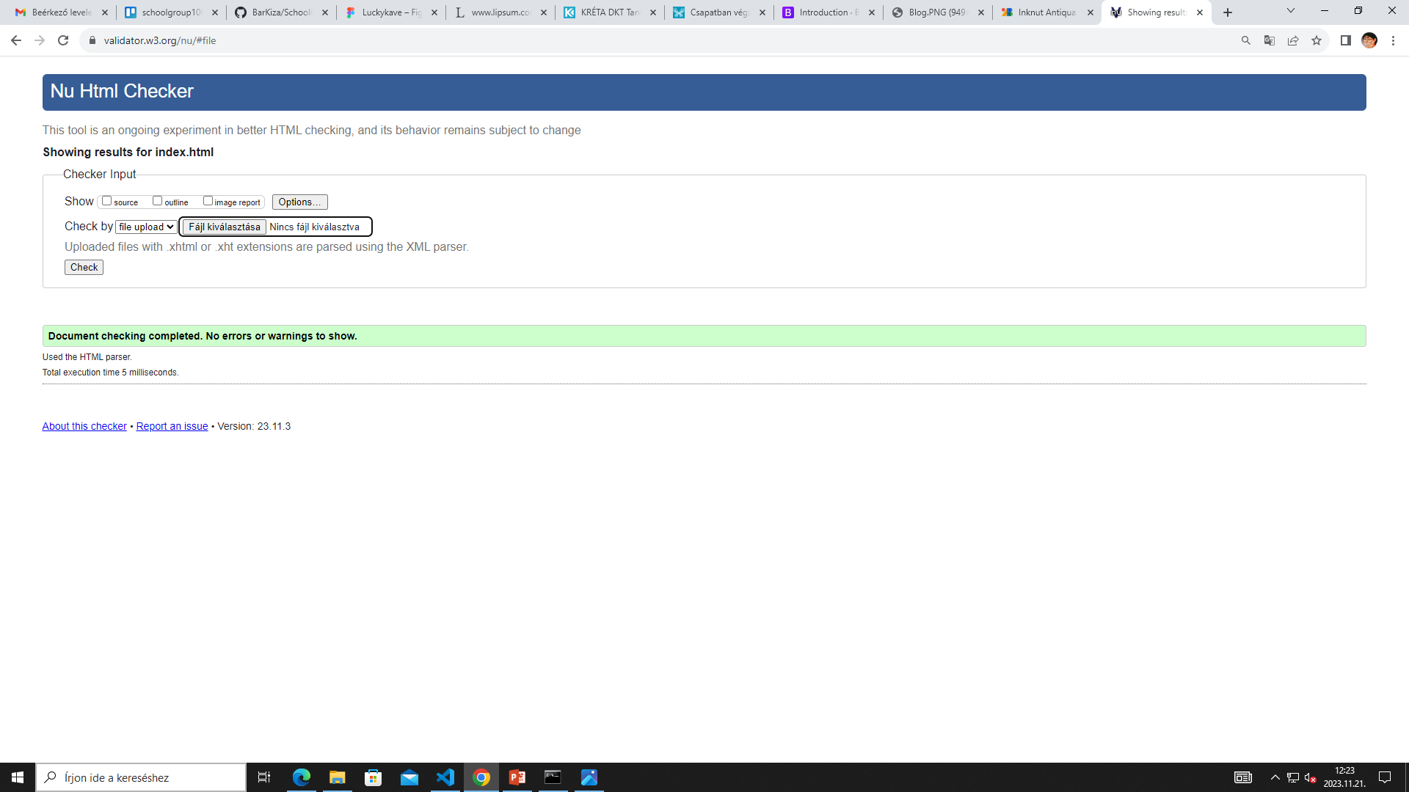
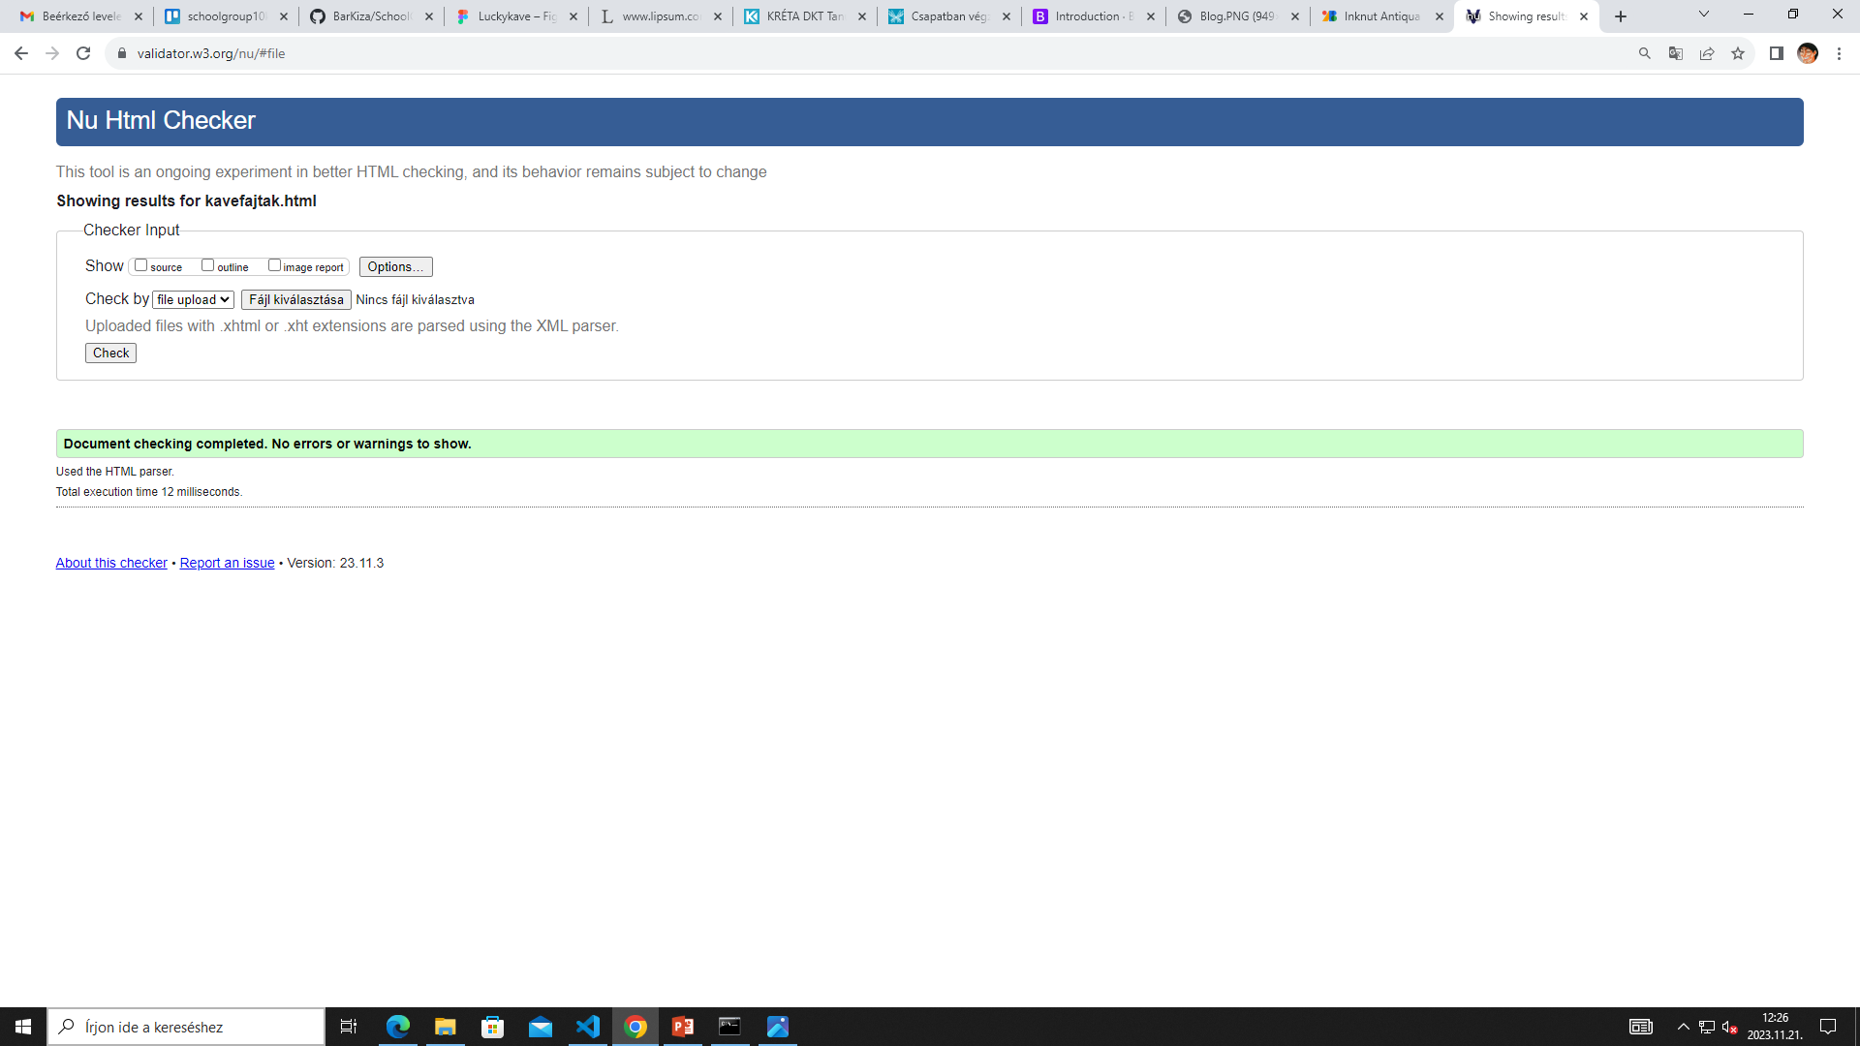


Validation images

Slide 6
Working tools
Trello
Github
Figma

Slide 7
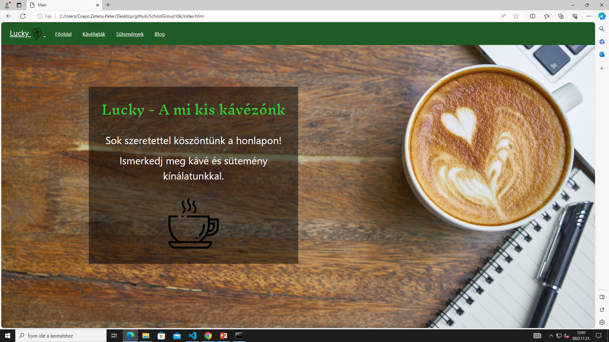
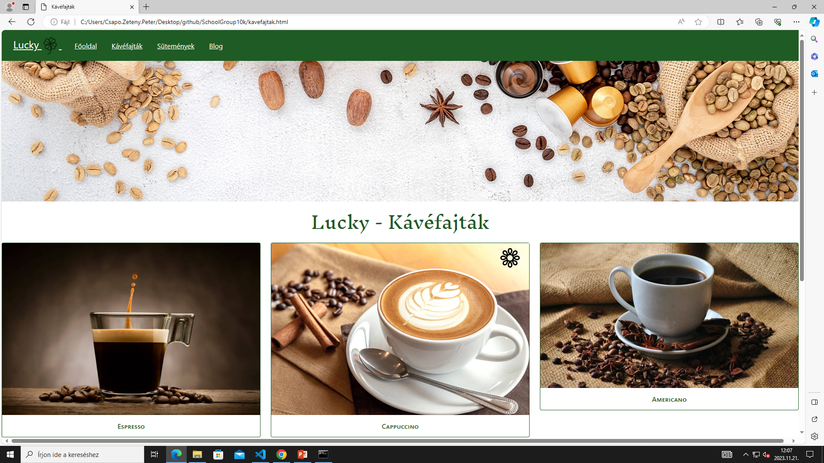
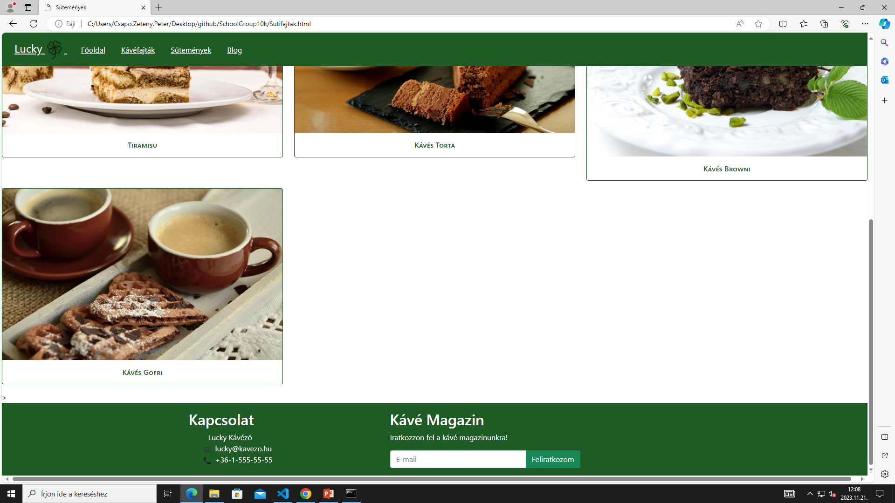
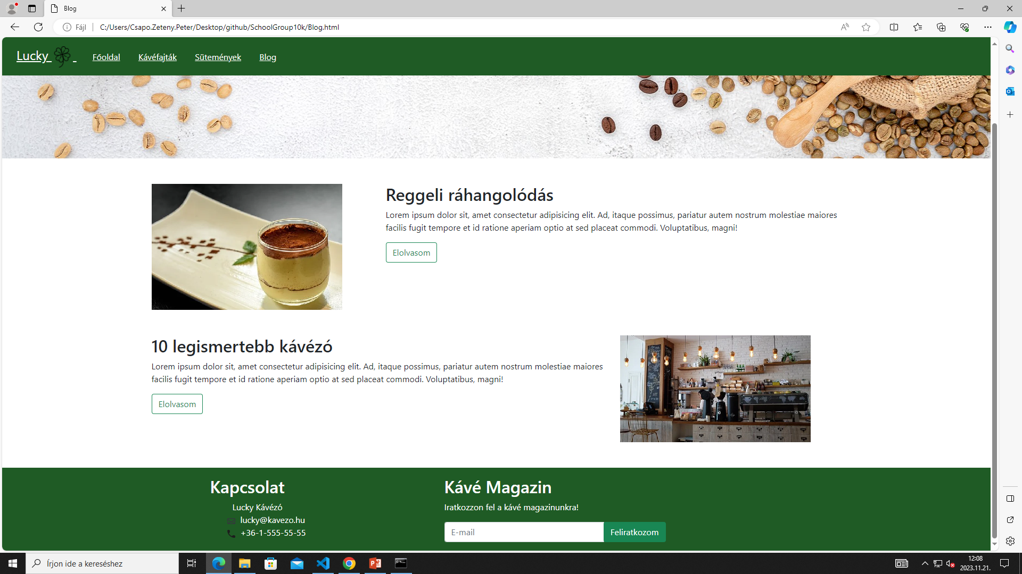
Images of pages

Slide 8
Link

Slide 9
Thank you for your attention!

